Slide 1
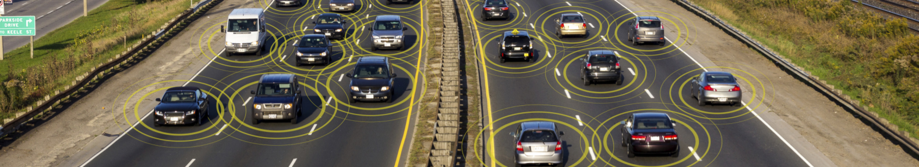
Connected Vehicle Applications and Protocols
Ashraf Drieas
Brandon Fins
Gabriel Almeida
Juan Inzunza
Mandy Ledford

Slide 2
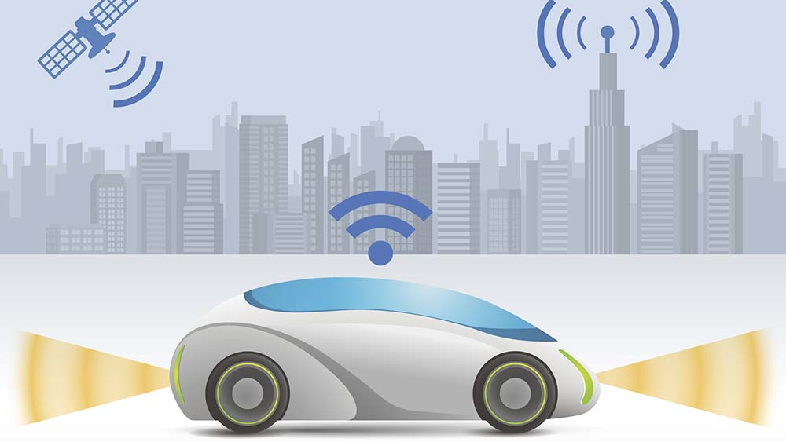
What is a Connected Vehicle?
A Connected Vehicle is a vehicle that can share data with other devices inside and outside of the vehicle
There are 5 types of Vehicle Communication:
Vehicle to Network
Vehicle to Infrastructure
Vehicle to Vehicle
Vehicle to Pedestrian
Vehicle to User

Slide 3
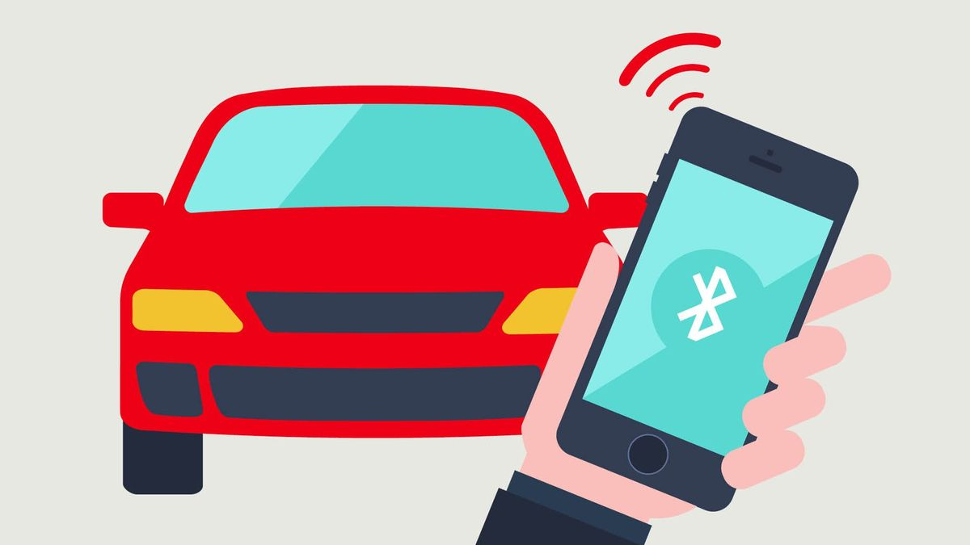
Connected Vehicles in everyday life
You probably use Vehicle communication every day…
Radio
GPS
BlueTooth
Internet Connectivity
Emergency Communication
Blind Spot Sensor
Back up Camera
This industry is only getting bigger and better and more connected.

Slide 4
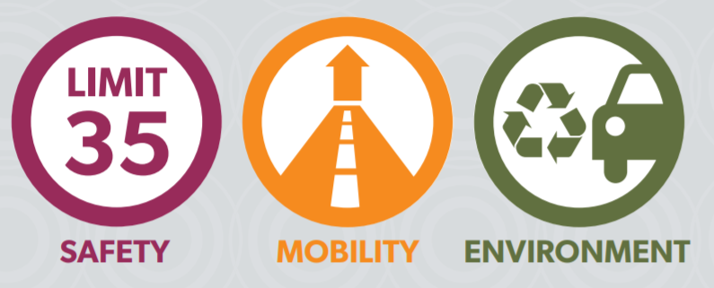
Benefits of Connected Vehicles
According to the United States Department
of Transportation Connected Vehicles
Benefit:
Safety
Safety applications will give drivers the tools they need to avoid potential crashes and significantly reduce the number of lives lost each year.
Mobility
Mobility applications will help drivers navigate the roads more efficiently, help system operators improve the operation of our nation’s transportation system, and reduce congestion and travel delay.
Environment
Environmental applications will give motorists the real-time information they need to make “green” transportation choices.

Slide 5
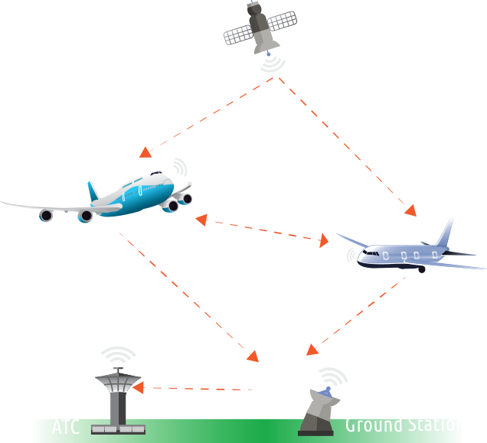
Not just for cars: ADS-B
Automatic dependent surveillance—broadcast
Surveillance technology in which an aircraft determines its position via satellite navigation and periodically broadcasts it
Information can be received by air traffic control ground stations
Also received by other aircraft to provide situational awareness and allow self-separation.

Slide 6
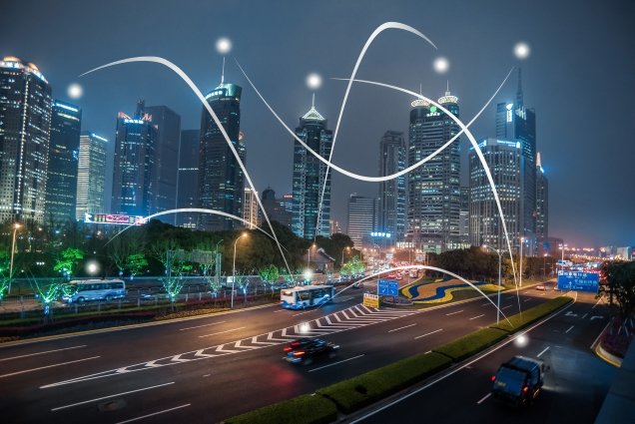
Vehicle-to-Network Communication (V2N)
V2N systems connect vehicles to the the cloud so drivers can take advantage of in-vehicle services
Hotspot for internet connectivity
Traffic Updates
Road Closures
Congestion
Media Streaming
V2N communication provides non-critical but useful information

Slide 7
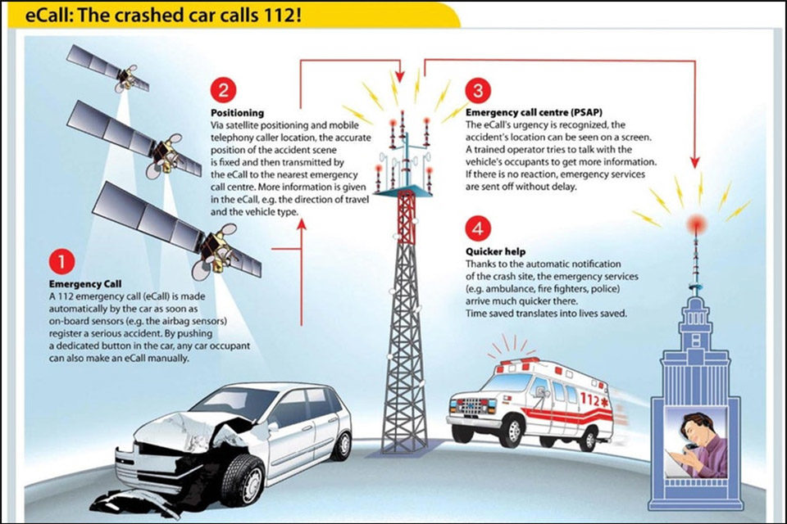
V2N Driver Assistance systems
V2N communication has been applied to Driver Assistance system
Example: EU system “E-Call”
Exploits internet communication for driver support
Automated message to emergency services following a crash, with exact location of crash
Maintenance updates
Remote diagnostics
Finnish study estimated the “E-Call” system would reduce between 4-8% of road deaths

Slide 8
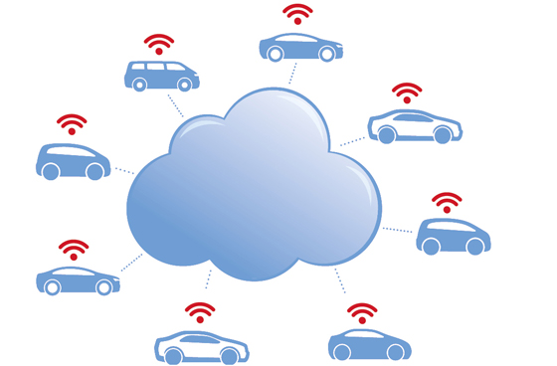
V2N Data Analysis
A V2N connection can provide a broad set of sensor data such as:
GPS coordinates, speed limit, engine RPM, engine temperature, rain detection, humidity, camera information ect.
Companies like Google would like to use this information in data Analysis for the purposes of:
Usage based Insurance - safe drivers rewarded with lower insurance premiums
Predictive maintenance - the vehicle can alert the driver of recommended maintenance
Freight tracking
Customized in-vehicle experience - Tailor the in-vehicle experience to specific driving behaviors

Slide 9
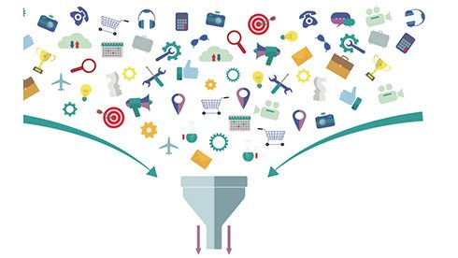
V2N Challenges
To take greater advantage of V2N communication we need to collect more data, and large data collection comes with problems. The platform must be able to deal with:
Device management
Data ingestion
Data Analysis
Predictive models

Slide 10
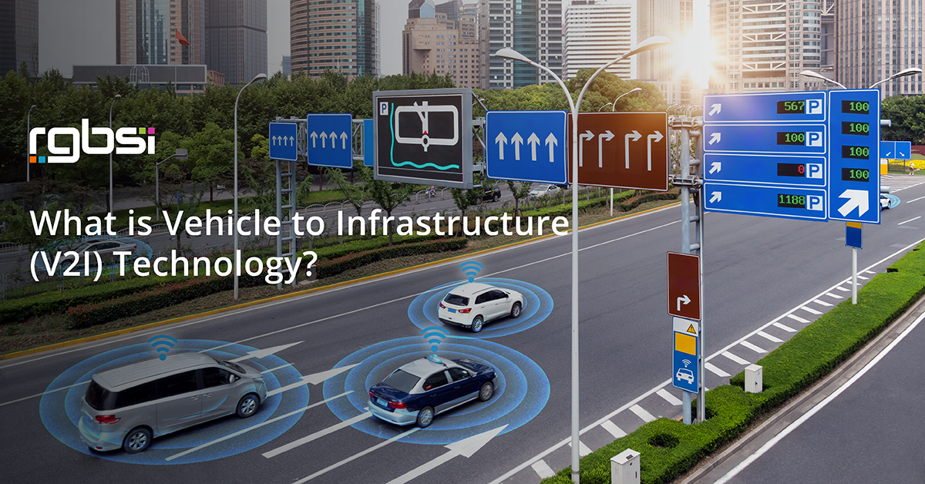
Vehicle-to-Infrastructure Communication (V2I)

Slide 11
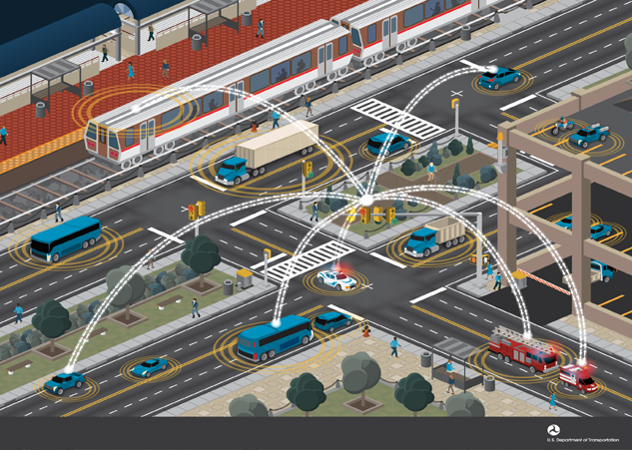
What is V2I?
According to rgbsi.com, Vehicle to Infrastructure(V2I) is “a communication framework that enables several vehicles to share information with a variety of devices supporting the highway system of a particular country.”

Slide 12
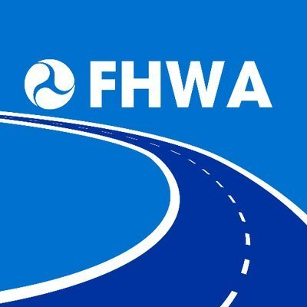
Importance of V2I
In 2017, the Federal Highway Administration(FHWA), announced Vehicle-to-Infrastructure Guidance
Major points of this were:
Accelerate the deployment of V2I communication systems
V2I communication is a critical component of a connected vehicle communication
Assist Transportation System owners/operators as they deploy V2I technology

Slide 13
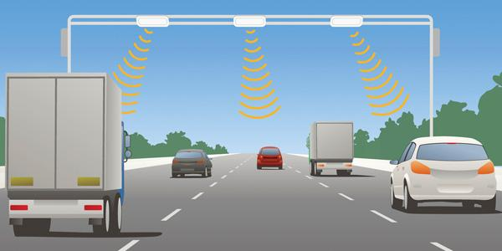
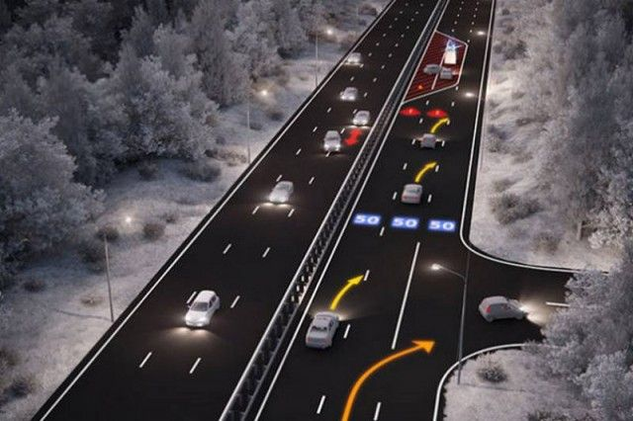
V2I Devices
They include, but not limited to:
RFID readers
Signage
Cameras
Lane Markers
Streetlights
Parking meters
Wireless Communications

Slide 14


How does V2I work?
Enabled by a network of:
Hardware
Software
Firmware
Technology used is typically wireless and bi-directional

Slide 15
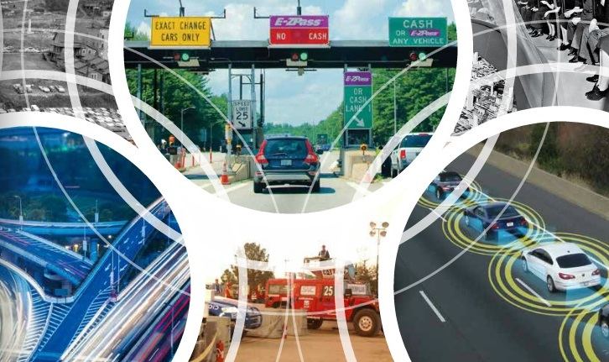
How does V2I work...
V2I employs dedicated short-range communication(DSRC)
Sensors are used in intelligent transportation systems(ITS), to capture data and used by traffic management supervision systems

Slide 16
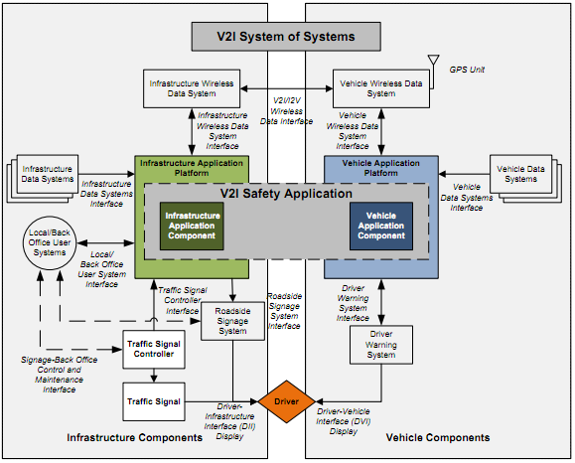
How does V2I work...

Slide 17
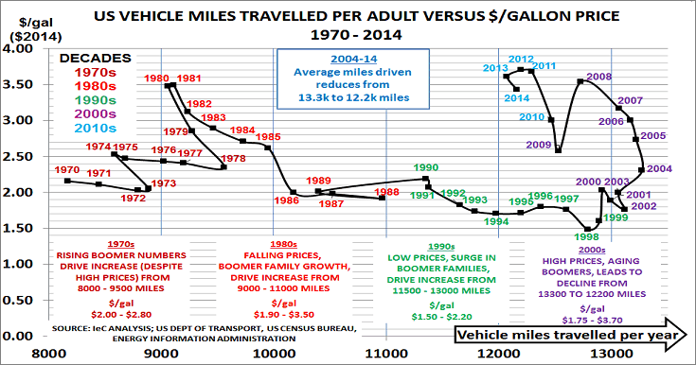
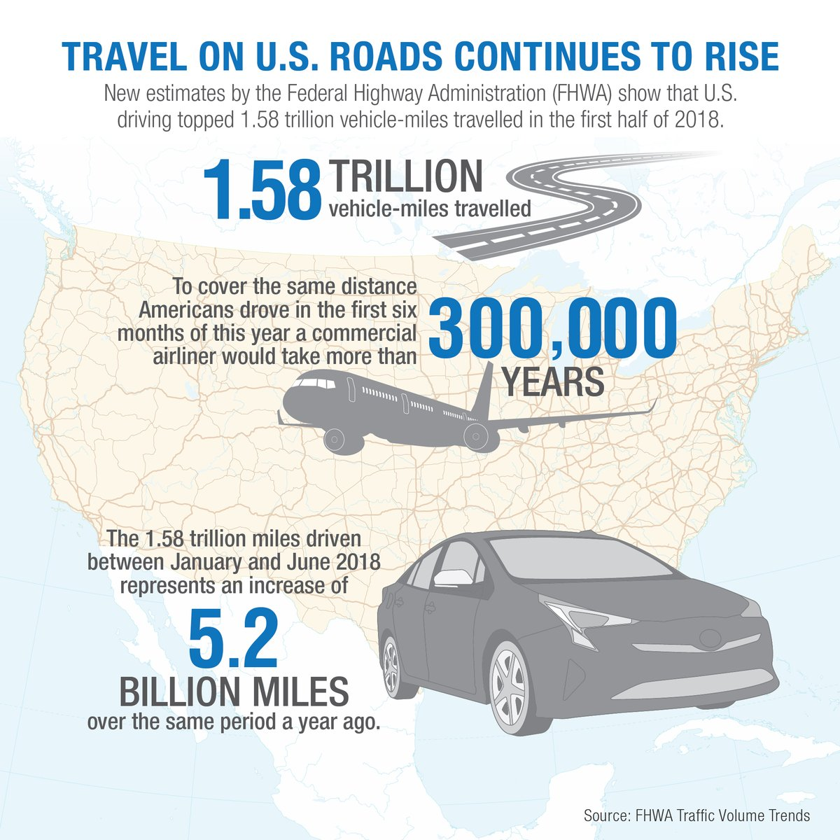
Benefits of V2I
Benefits include, but aren’t limited to the following:
Real time advisories about various incidents on the road
Set speed limits and modify signal phase and timing(SPaT)
Traffic reduction and time saving
Increased Safety

Slide 18
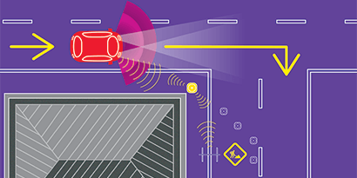
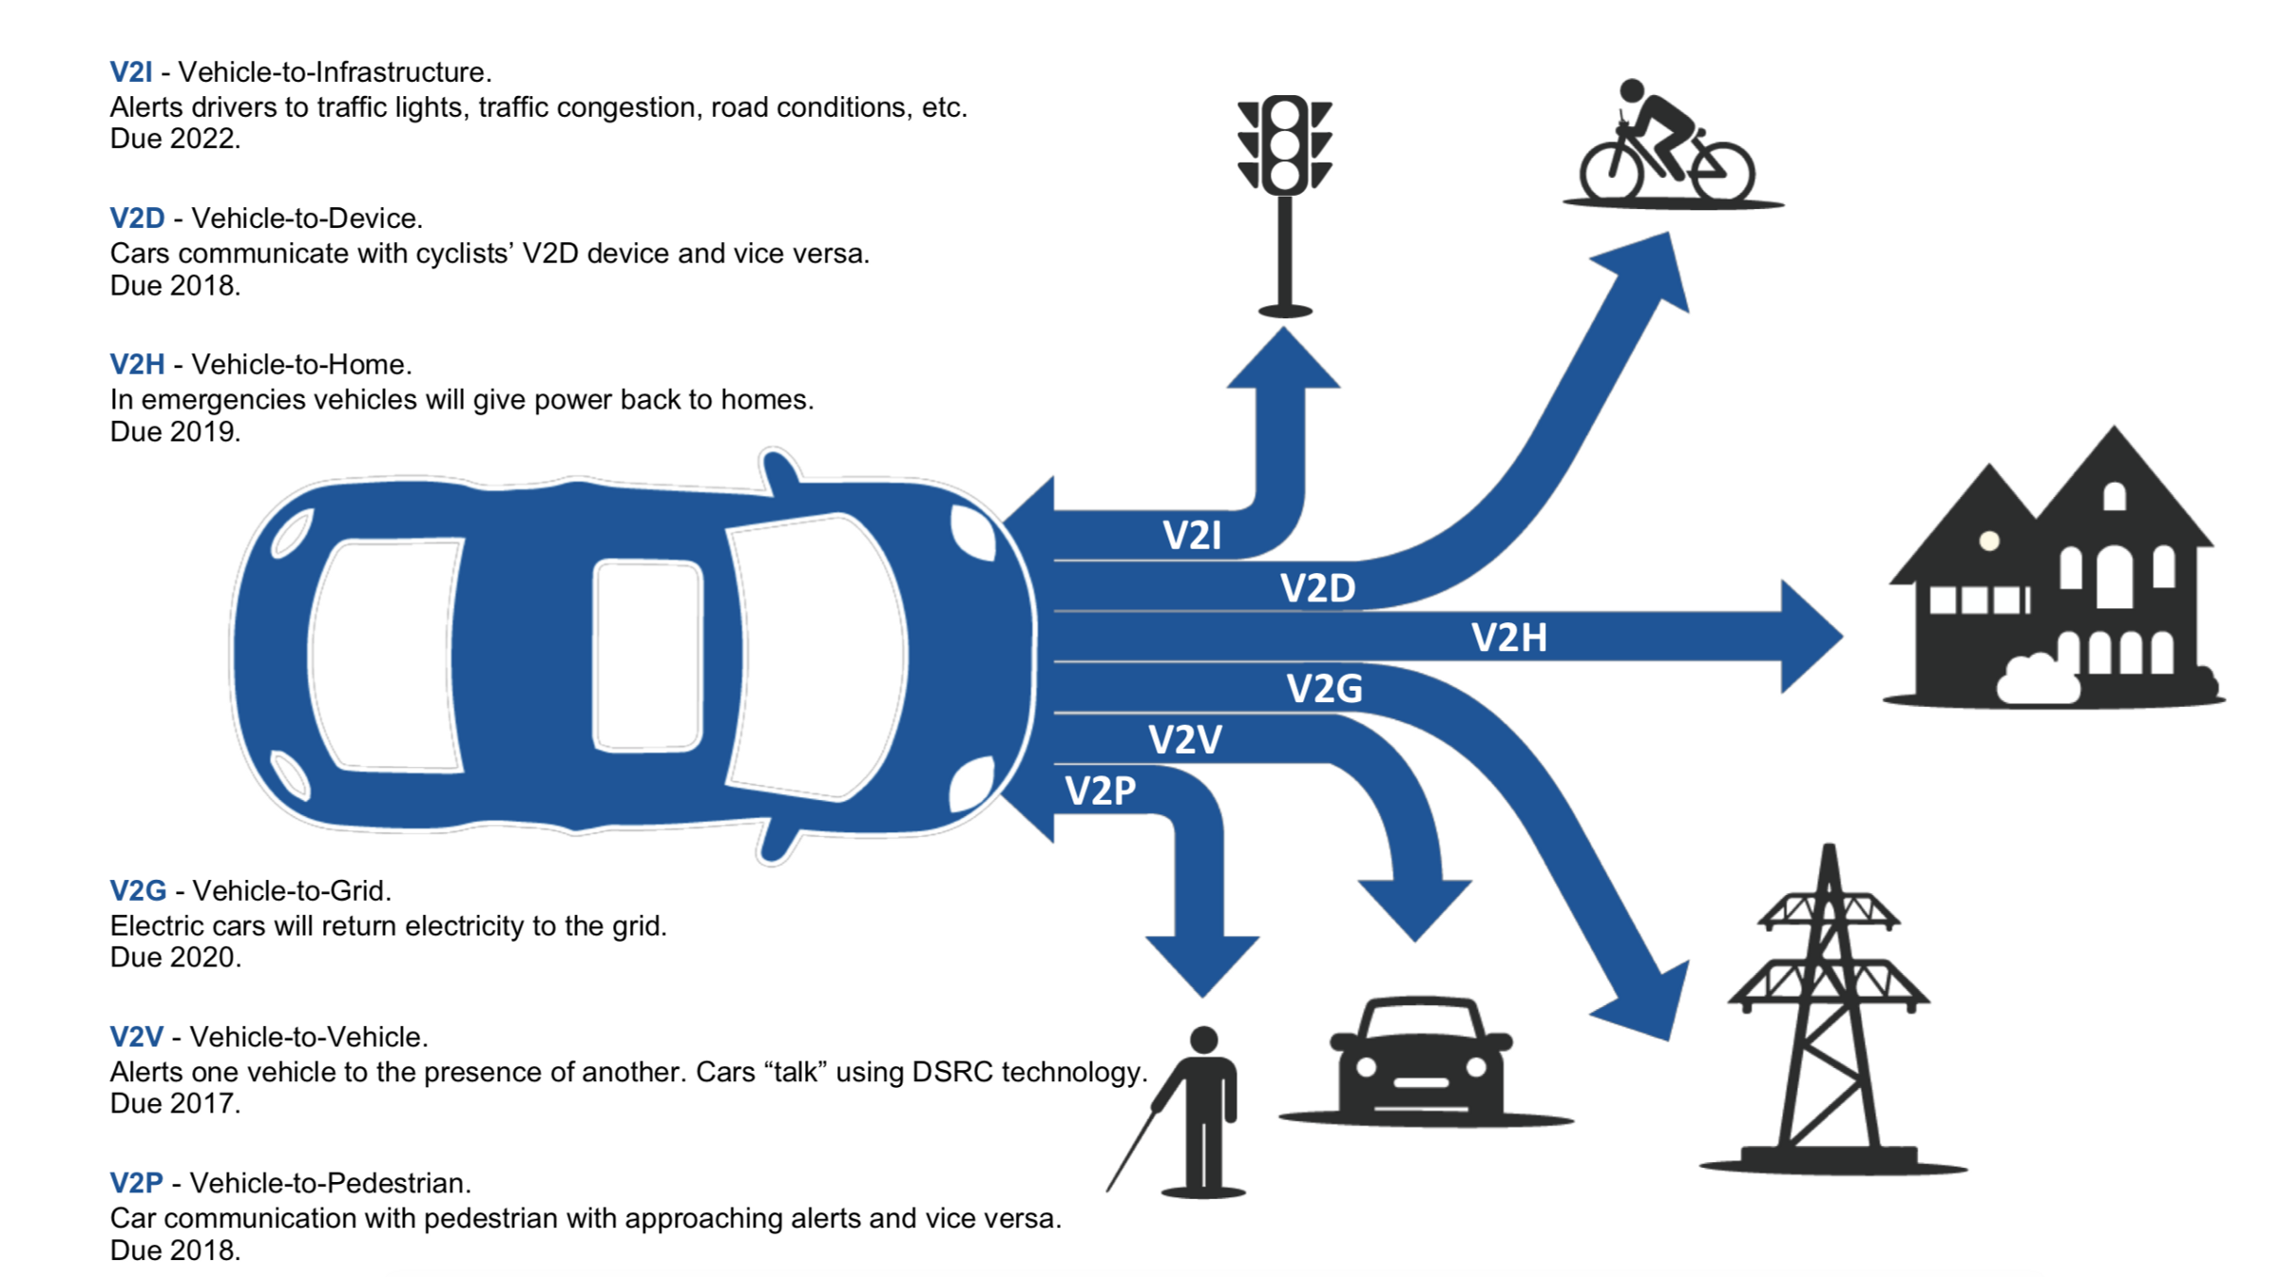
V2I Challenges
Road infrastructure will need to move from analog to digital
Of all the connected vehicle applications, V2I development and deployment is the slowest

Slide 19
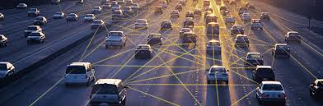
Vehicle-to-Vehicle Communication (V2V)
Vehicle-to-Vehicle Communication (V2V)

Slide 20
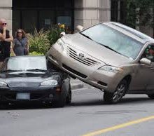
Vehicle-to-Vehicle Communication (V2V)
Did you know?
6.3M Police-reported motor vehicle crashes in 2015.
615,00 Number of motor vehicle crashes that could be prevented using V2V technology.
1,366 Number of lives that could be saved using V2V technology.

Slide 21
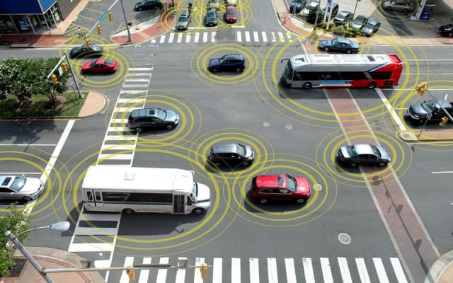
What is V2V?
Vehicle to Vehicle communication ability is to wirelessly exchange information about speed, position, and direction of surrounding vehicles.

Slide 22
How does V2V work?
V2V uses dedicated short-range communications (DSRC), a variation of Wi-Fi tailored for moving vehicles.
This technology allows vehicles to rapidly broadcast and receive messages (up to 10 times per second) so there is a 360-degree “awareness” of other vehicles in the proximity.
These V2V communication messages have a range of more than 300 meters and can detect dangers obscured by traffic, terrain, or weather.

Slide 23
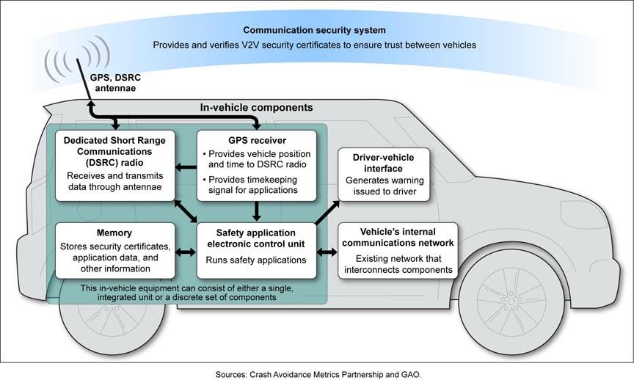
How does V2V work?

Slide 24
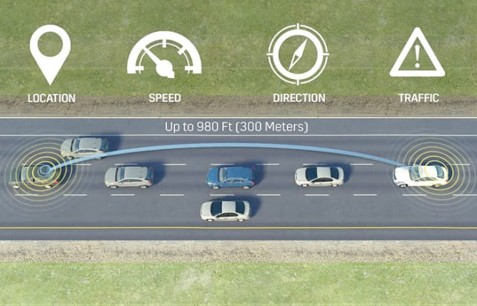
Advantages of Vehicle-to-Vehicle Communication (V2V)
Lane-passing assistance: The vehicles would be able to communicate with each other and could warn each driver of oncoming cars to avoid head-on crashes.
Intersection Assistance: The vehicles would be able to communicate with other vehicles and would be aware of another approaching vehicle entering the intersection and alert the driver.
Money and Gas Savings: The vehicles would be able to help reduce the amount of gas wasted in traffic jams each year. With also the ability to reduce crashes and minimize traffic delays, it would save drivers time and fuel costs.

Slide 25
Disadvantages of Vehicle-to-Vehicle Communication (V2V)
The threat of hacking: Being IT-dependent system, they are vulnerable to attacks of hacking or cracking. In such a situation, the hacker can alter the information displayed in the vehicle.
Additional cost: The estimated cost of installing the V2V communication system in the vehicle is high. It could be in the range of 2,000 USD to 20,000 USD depending upon the vehicle model and complexity of the system.
The frequency band set aside for this system can’t support a large number of vehicles simultaneously.

Slide 26

Applications of Vehicle-to-Vehicle Communication (V2V)
AutoPi ($125 - $330)
The AutoPi dongle and the AutoPi Cloud combines to an IoT Platform which lets you add advanced features to your car and gives you a lot of extension possibilities.
Abilities:
Traffic sign warning
Theft detection
Parking assistance
Crash detection
Collision prevention
Parental control
Can add on future features.

Slide 27
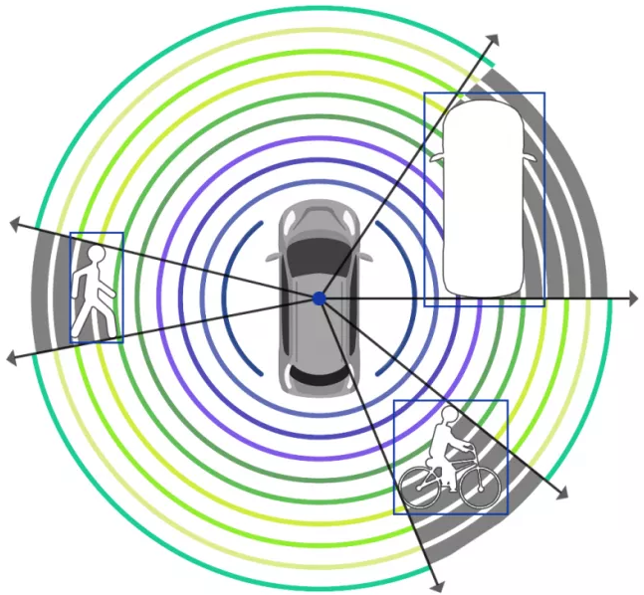
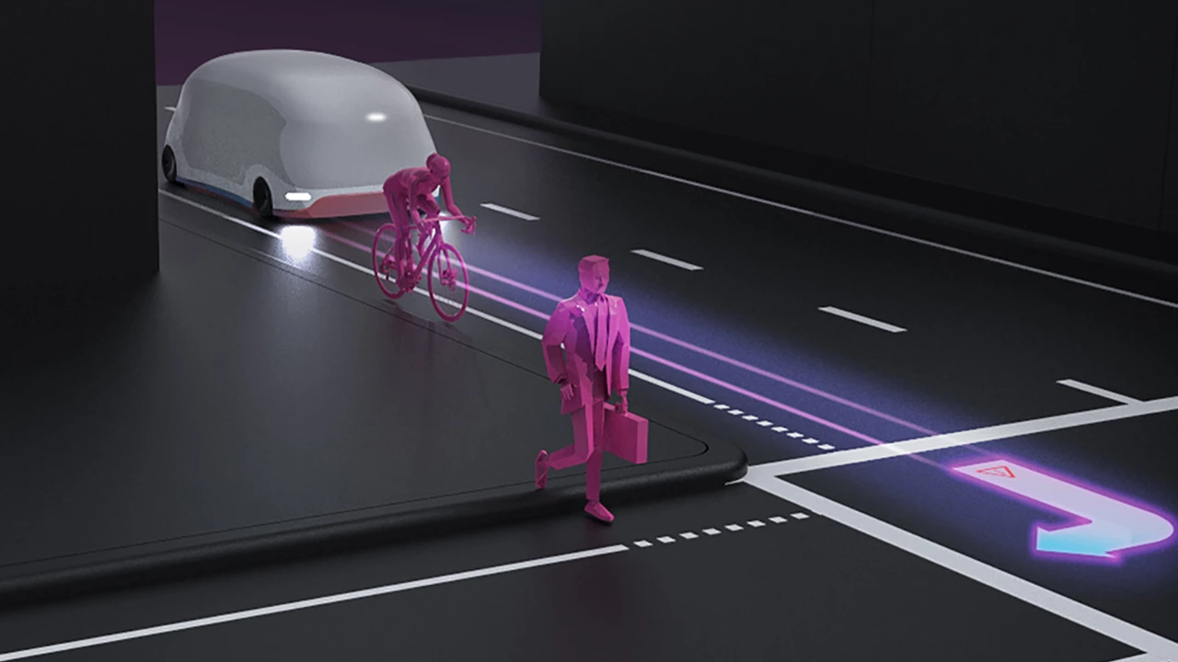
Vehicle-to-Pedestrian Communication (V2P)
The foundation of AV technology is effective detection
Vehicle-based sensors can fail to identify pedestrians even in ideal conditions
Uses a suite of different sensors to detect pedestrians

Slide 28
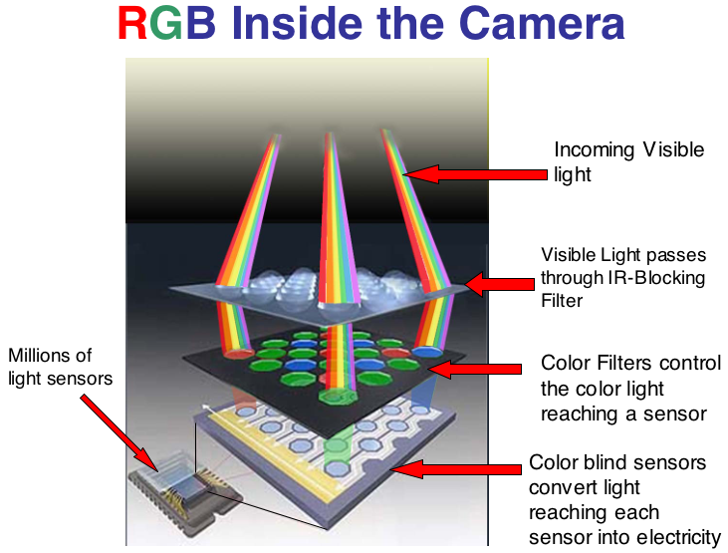

V2P Sensors
VLCs - Visible light cameras
Capture images and send them to onboard computers, which compile and analyze them for pedestrians and objects
Function poorly in low-light conditions, in adverse weather conditions, and on slick surfaces

Slide 29
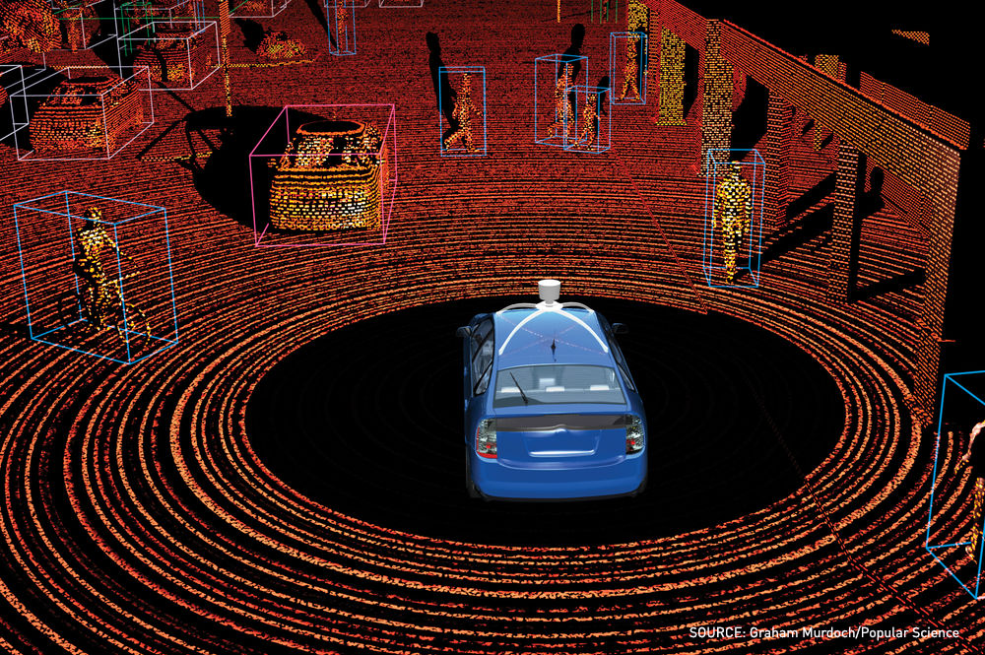
V2P Sensors...
LiDAR - light detection and ranging
Uses scanning lasers to measure distances to surfaces, producing a 3D map of detailed shapes
Capable of object detection in low/no-light conditions
Unreliable in adverse weather and when road surfaces are wet or reflective
Potentially useful for medium- and long-range detection

Slide 30
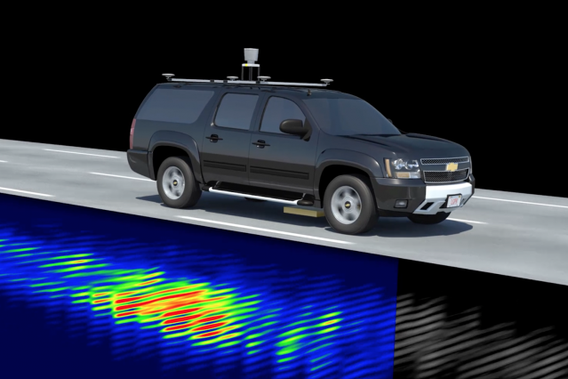
V2P Sensors...
Radar - RAdio Detection And Ranging
Uses radio waves to detect objects and determine distances and relative speeds
Handles darkness and adverse weather conditions well, but has poor resolution, making it difficult to distinguish pedestrians, especially children
Cannot reliably detect stationary objects, such as pedestrians waiting to enter a roadway

Slide 31
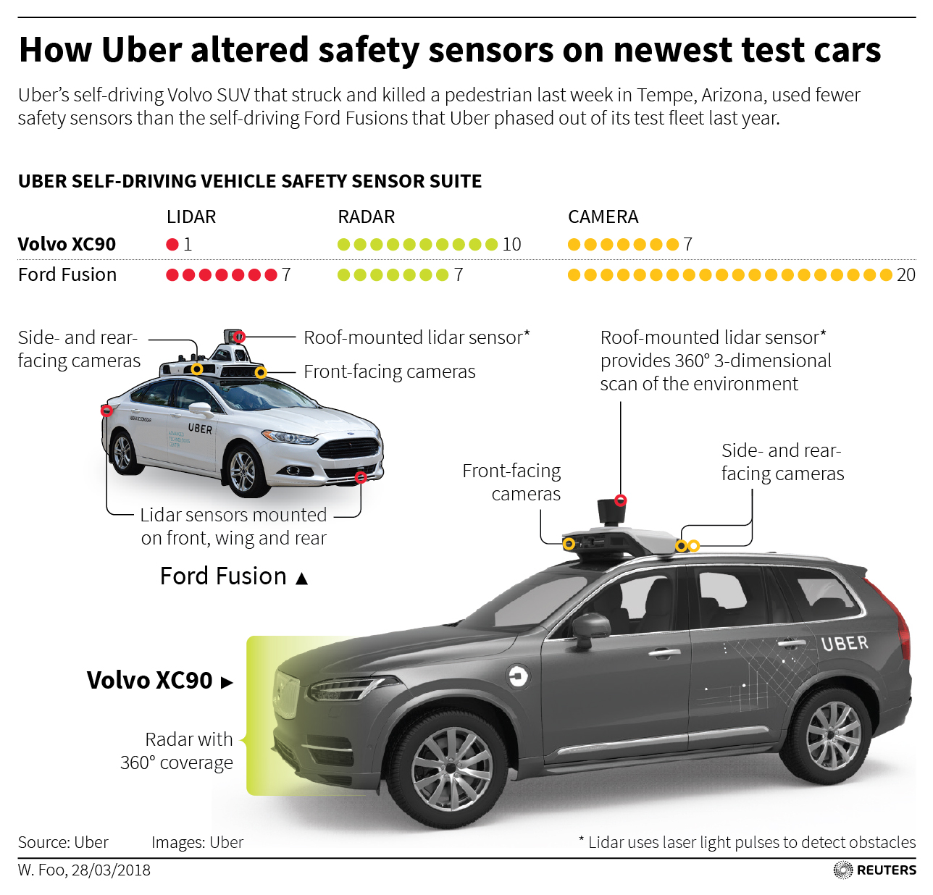
V2P Uber Example
New Uber vehicle scaled back lidar from 7 units to 1
Introduced a blind zone around the perimeter of the SUV
The lidar now sits up higher on top of an SUV, further reducing its ability to see low-lying objects

Slide 32
V2P Improvements
How can pedestrians be protected?
The most affordable detection technology, cameras, is unlikely to be effective in pedestrian fatality mitigation
Initial deployment of automated vehicles will likely be restricted to freeways and select urban areas, non-freeway streets and rural settings account for a substantial share of pedestrian fatalities.
Combining sensor technologies offers the greatest potential for eliminating fatalities, but may be unrealistically expensive
A tenfold improvement in this technology is needed to replicate human performance

Slide 33
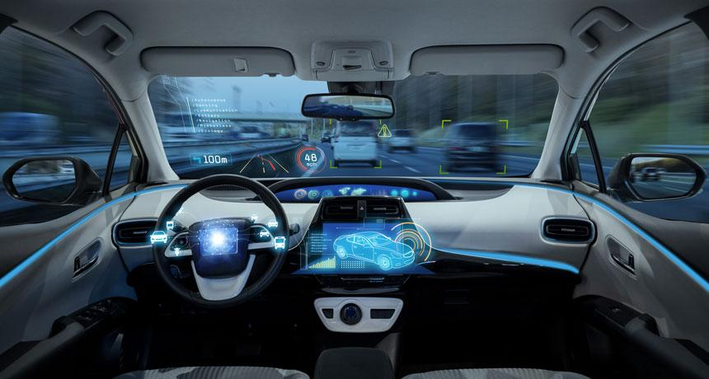
Vehicle-to-User Communication (V2U)

Slide 34
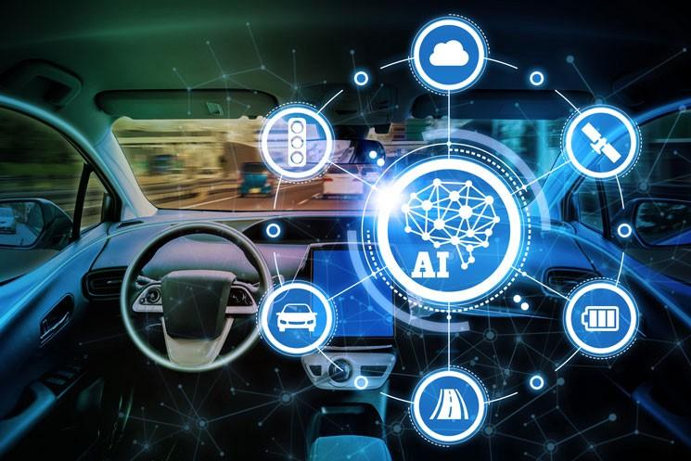
Definition
Vehicle to User technology refers to communication between the vehicle and its occupants, especially the driver
Two primary categories:
Driver Assistance
In-vehicle Infotainment

Slide 35

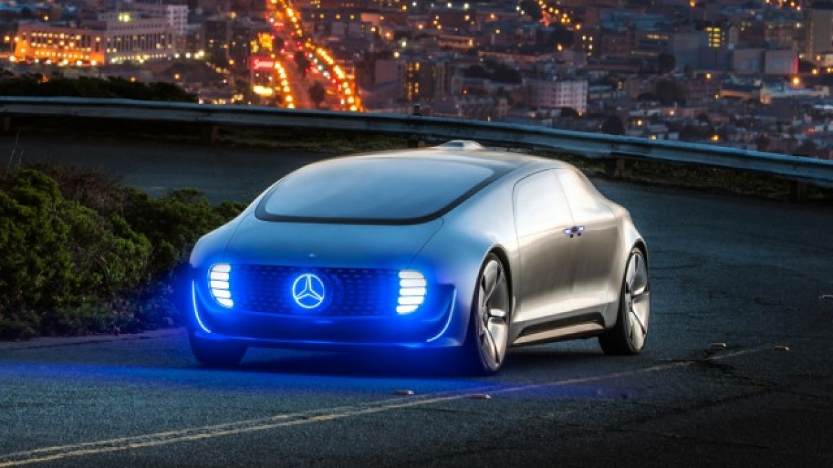
Background: Autonomous Vehicle Rating System
The Society of Automotive Engineers released industry accepted level system to rate autonomous vehicles
Vehicles classified on a scale of 1-5, in ascending order by level of autonomy.

Slide 36
Background: Autonomous Vehicle Rating System
Level 0: No Automation
Relies on driver for all driving actions
Level 1: Driver Assistance
Basic automation; cars with cruise control or lane-keep technology
Level 2: Partial Automation
More advanced automation; car can at times control braking, steering, or acceleration of the vehicle
Level 3: Conditional Automation
Vehicle is capable of taking full control and operating during select parts of a journey when certain operating conditions are met.
Level 4: High Automation
Vehicle can complete an entire journey without driver intervention; may have geographical or movement constraints
Level 5: Full Automation
Fully autonomous vehicle in all circumstances; zero driver-input necessary
Current technology is at Level 2

Slide 37
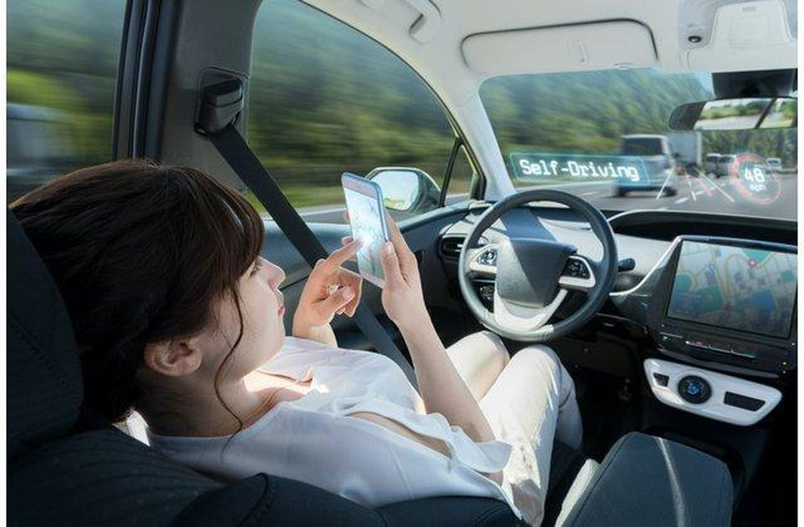
Current Technology
There is a misconception about current automated driving technology
We are a long ways away from having fully-autonomous vehicles
Until then, vehicles will become more and more automated
Current technology is at Level 2

Slide 38
Two Primary Categories
Driver Assistance Technology
Technology designed to assist the human driver and in some situations, take over certain tasks when deemed necessary.
Infotainment
In-vehicle hardware and software that provides audio or video entertainment

Slide 39
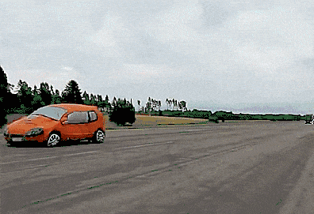
Automated Driver Assistance Systems (ADAS)
ADAS systems are designed to help the driver in the driving process.
ADAS can warn drivers of potential dangers, intervene to help the driver remain in control in order to prevent an accident and, if necessary, reduce the severity of an accident if it can’t be avoided.

Slide 40
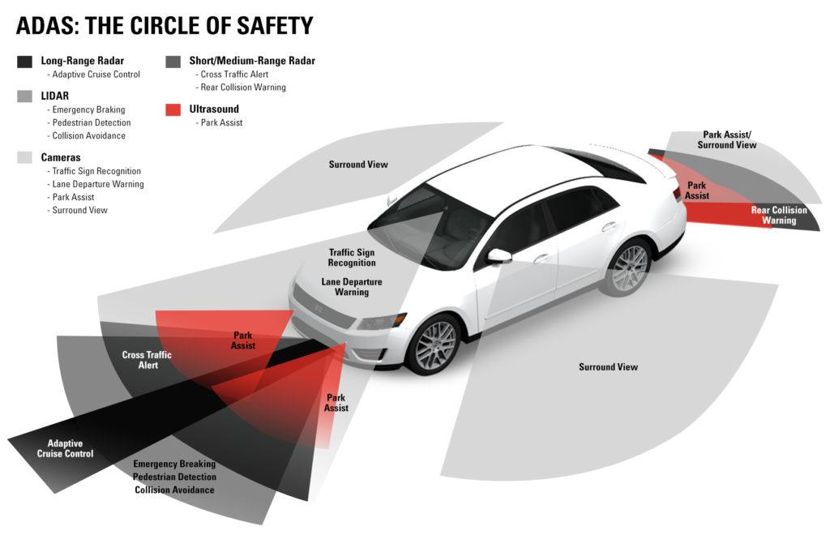
Automated Driver Assistance Systems (ADAS)
Do you have some of the following systems in your car?
Automatic emergency braking
Pedestrian automatic emergency braking
Rearview video systems
Forward collision warning
Lane departure warning
Lane keeping support
Adaptive light control
Blind spot detection
911 Notification

Slide 41
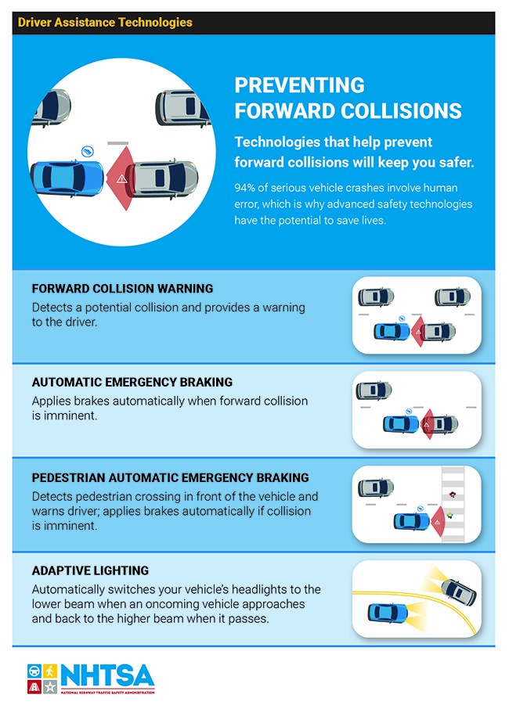
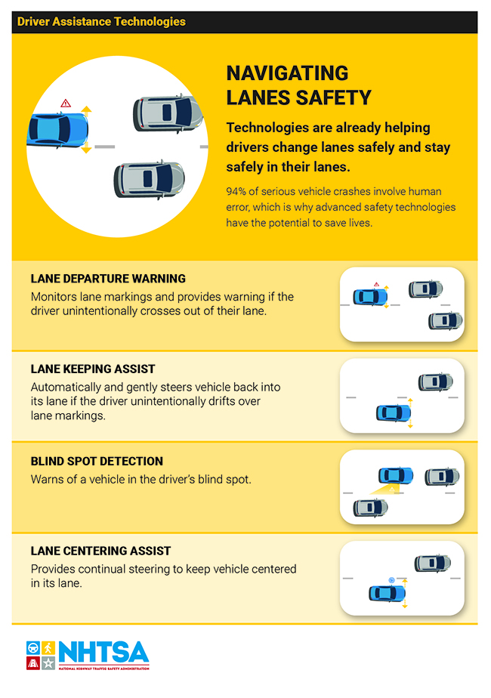
National Highway Traffic Safety Administration (NHTSA)
ADAS- The New Standard
NHTSA endorses approved driver assistance technology, and encourages consumers to look for recommended safety features when shopping
Automotive Industry is increasingly integrating ADAS technology into their vehicles.

Slide 42
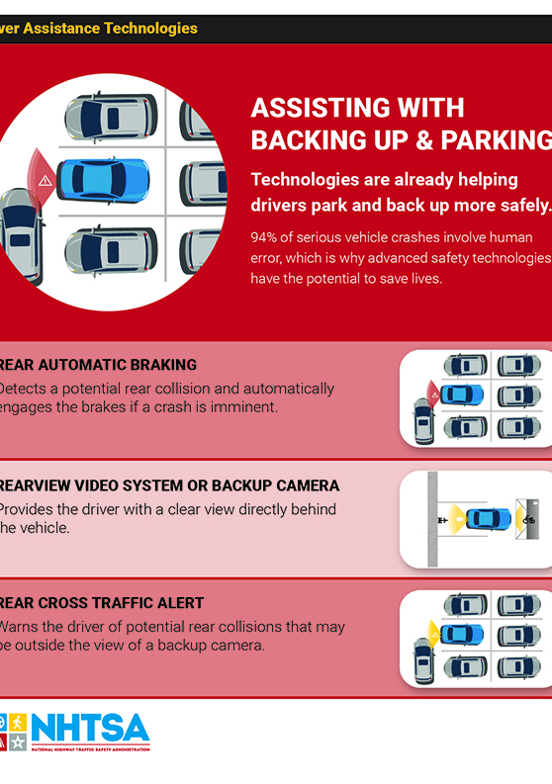
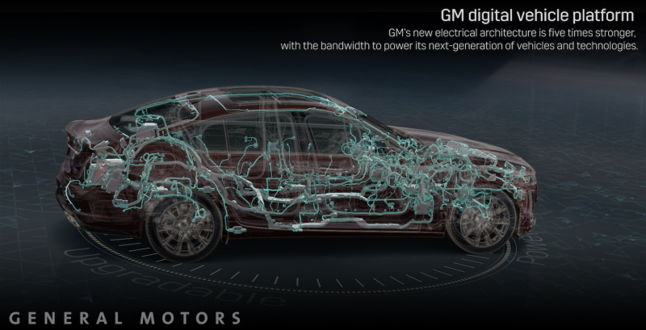
National Highway Traffic Safety Administration (NHTSA)
Increased Processing Power
GM’s newly unveiled platform has the power to process 4.5 TB of data per hour
Also provides more rapid communications within the vehicle itself and to outside sources with Ethernet connections of 100 Mbps, 1 Gbps and 10 Gbps.
The new technology is expected to be installed in GM vehicles by 2023

Slide 43
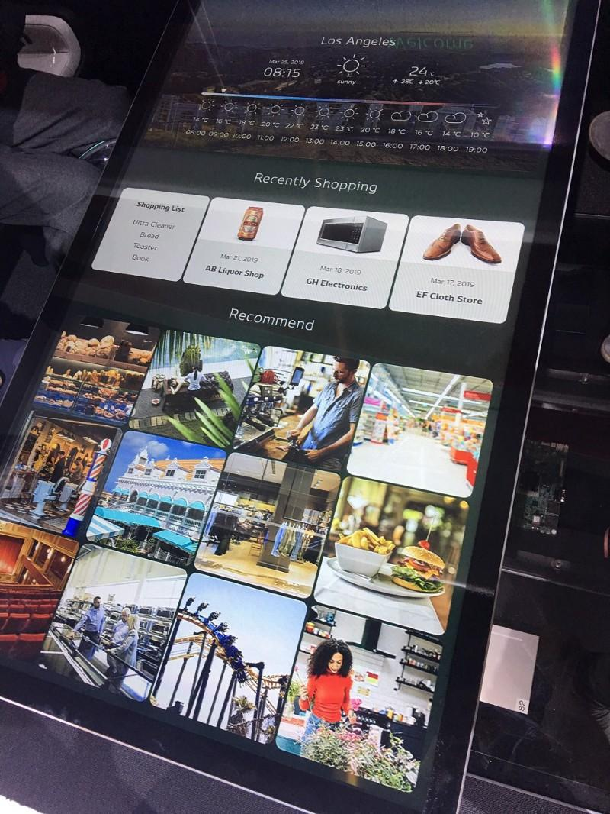
In-Vehicle Infotainment (IVI)
What infotainment do you have in your vehicle?
Just as with ADAS, IVI is a massively growing industry
As we grow closer to building fully-autonomous cars, drivers and passengers will have more time to consume content while in their cars.
Major research goes into designing increasingly fluid UI’s with ease of access and simplicity at their core.

Slide 44
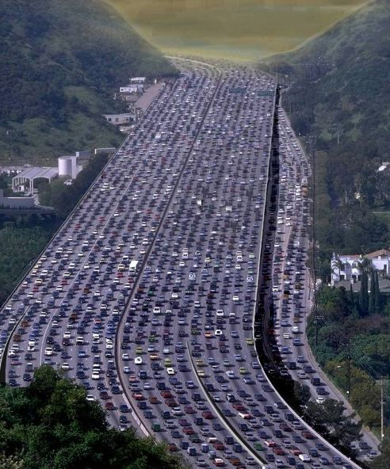
In-Vehicle Infotainment (IVI)
According to U.S. Census Bureau data, average one-way commute time in U.S is 26.1 minutes.
Commute times continue to rise
People spending more time in their cars means more data consumption and increased purchasing decisions while on the road.

Slide 45
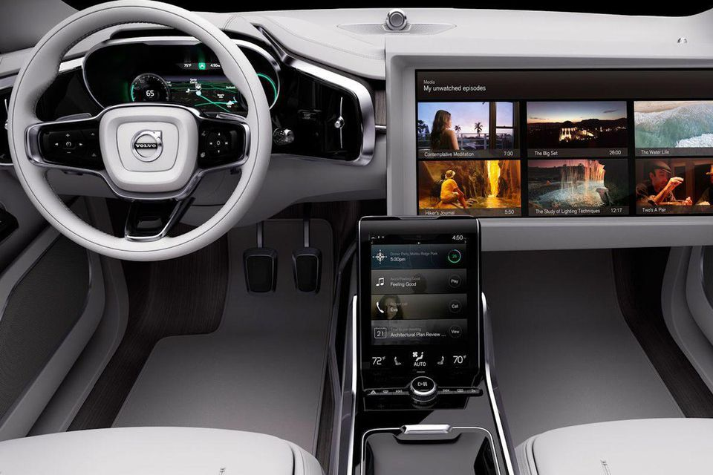
In-Vehicle Infotainment (IVI)
With the evolution of smartphone technology, consumers expect connected vehicles

Slide 46
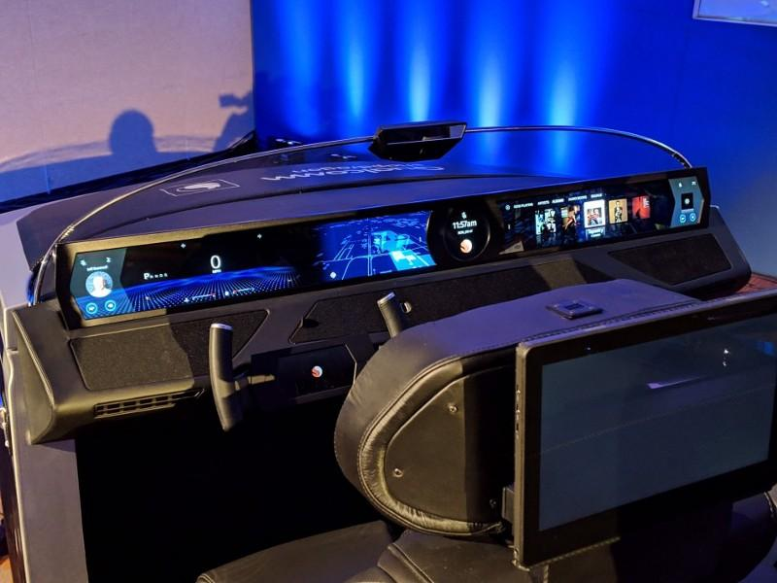
Future Technology
Redesigned driver cockpits
As vehicles automation evolves, so does our experience in the driver’s seat
Driver cockpits of the future may look very different than what we have now

Slide 47
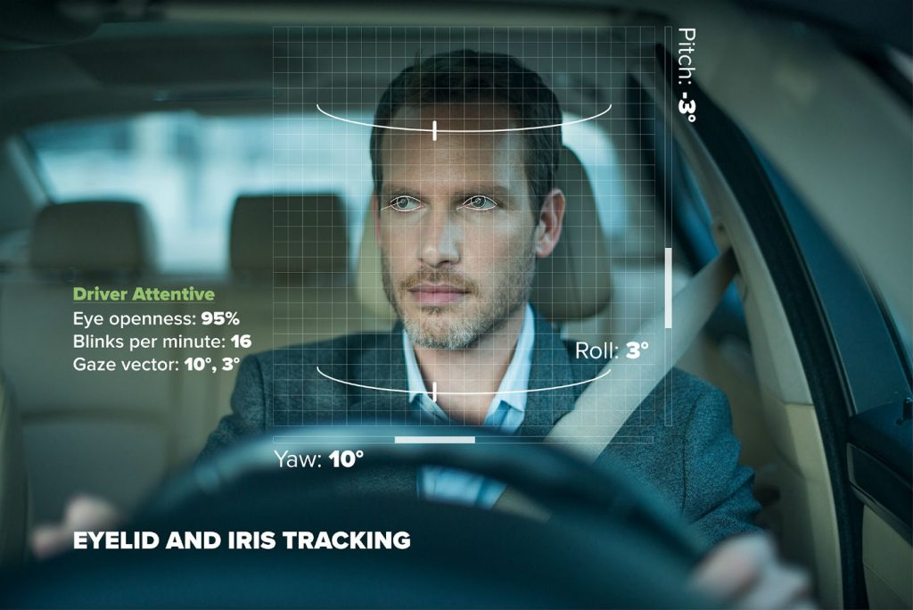
Future Technology
Driver-monitoring technology is already being implemented in the trucking industry
A.I. technology monitors the emotions and alertness of the driver; can recognize when a driver is angry, drowsy, or distracted.

Slide 48
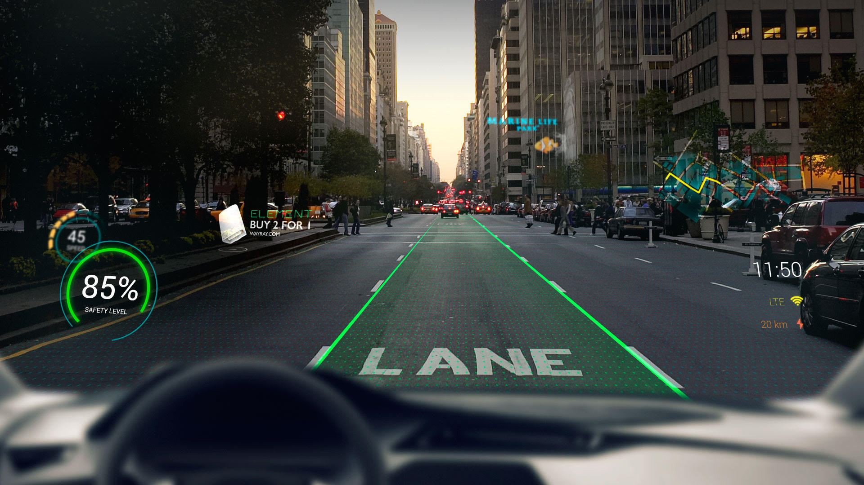
Future Technology
Augmented Reality
As material science improves, so will AR technology
Current tech startups are already utilizing smartphones for AR-enhanced navigation applications.

Slide 49
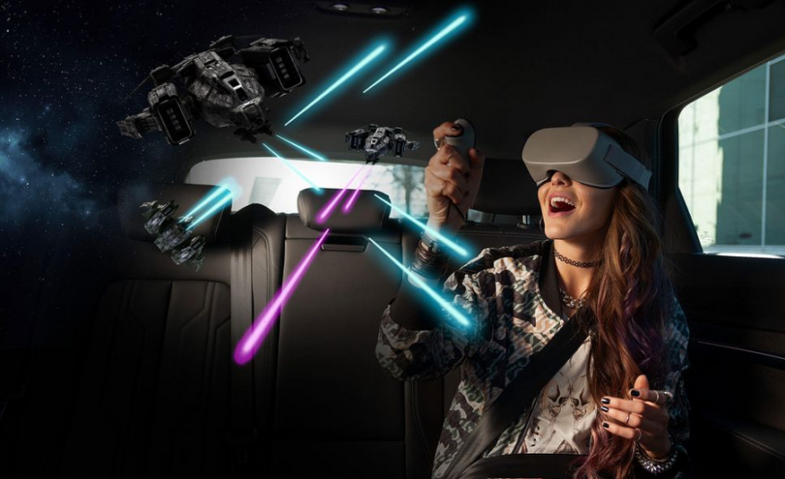
Future Technology
Virtual Reality
Holoride, an Audi spinoff company, revealed their in-vehicle VR technology at CES 2019
In partnership with Disney, the company is working to create VR experiences that will synchronize will your daily commute.

Slide 50
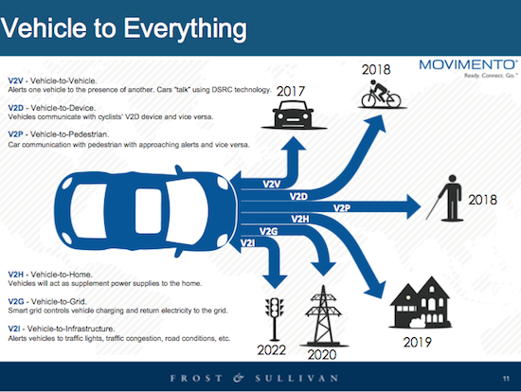
Conclusion
5 Types of Vehicle Communication (V2X):
Vehicle to Network
Vehicle to Infrastructure
Vehicle to Vehicle
Vehicle to Pedestrian
Vehicle to User

Slide 51
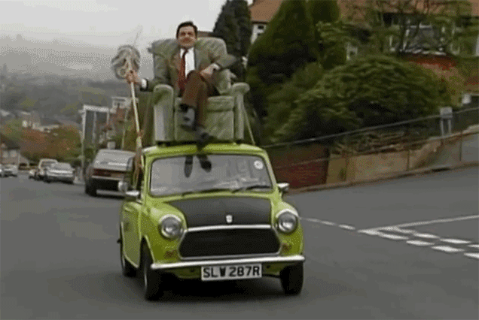
Conclusion
V2X Autonomous Vehicles
As V2X technology improves, it continues to pave the way for fully autonomous driving.
Society of Automotive Engineers: Vehicles classified on a scale of 1-5, in ascending order by level of autonomy.
Current vehicle technology is at the Level 2 sophistication rating.

Slide 52

Conclusion
Benefits of V2X technology:
Safety
Mobility
Environment
Growth: estimate by 2024 over 11.2 million cars will have the technology integrated in.
By 2022 V2X will have a global market of over $1.2 billion

Slide 53

Questions?

